Slide 1
MAR 530: Ecosystem Based Fisheries Management
Lecture 13
Moving towards Ecosystem Based Management
www.mycourses.umassd.edu
Acknowledgements: Erik Olsen, Institute of Marine Research Norway
1 May 2015

Slide 2
Last Time…
Evaluating tradeoffs
Management Strategy Evaluation

Slide 3
Today’s Outline
Beyond fisheries, moving toward Ecosystem-Based Management
Discussion on:
Leslie & McLeod 2007
Murawski 2007
Berkes 2011
Bunnefeld et al. 2011

Slide 4
One Main Theme Throughout Course
CONFRONTING TRADEOFFS

Slide 5
Simplified Schedule
Week | Theme | Topic
1/30 | Context | Introduction, What is EBFM?
2/6 |  | Challenges facing fisheries, what can EBFM offer?
2/13 |  | Guest lecture: case studies of EBFM
2/20 |  | Types of advice, decision theories, goal-setting
2/27 | Operational | Bycatch, habitat, and spatial management
3/6 |  | Ecosystem indicators
3/13 |  | Extended single-species and multispecies models
3/20 |  | SPRING BREAK
3/27 |  | Aggregate and system models
4/3 |  | Ecological risk assessment
4/10 | Institutional | Societal and economic considerations
4/17 |  | Governance and management institutions
4/24 | Holistic | Evaluating tradeoffs
5/1 |  | Moving towards ecosystem based management
5/8 |  | Final exam: Project Presentations

Slide 6
Ecosystem Based Management
Most of the case studies in this class have focused on EBFM.
However, a good deal of the literature we have read (particularly early in class) talked more generally about EBM.

Slide 7
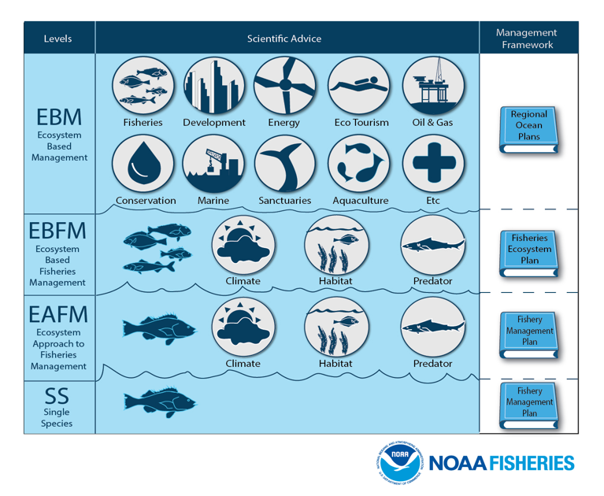

Slide 8
EBM Definitions
“U.S. ocean and coastal resources should be managed to reflect the relationships among all ecosystem components, including human and nonhuman species and the environments in which they live. Applying this principle will require defining relevant geographic management areas based on ecosystem, rather than political, boundaries.”
U.S. Commission on Ocean Policy

Slide 9
EBM Definitions
“Ecosystem based management is an integrated approach to management that considers the entire ecosystem, including humans. The goal of EBM is to maintain an ecosystem in a healthy, productive and resilient condition so that it can provide the services humans want and need. EBM differs from current approaches that usually focus on a single species, sector, activity or concern; it considers the cumulative impacts of different sectors”
(McLeod et al. 2005)

Slide 10
Example Efforts at Defining EBM
Marine
Larkin 1996
Botsford et al. 1997
EPAP 1999
Link 2002
Pikitch 2004
USCOP 2004
POC 2004
Browman & Stergiou 2004
General/Terrestrial
Slocombe 1993
Grumbine 1994, 1997
Haueber 1996
Christensen et al. 1996
Yaffee et al. 1996
Franklin 1997
Boyce & Haney 1997
Lackey 1998

Slide 11
Key elements
Connections
between marine ecosystems and social systems
Cumulative Impacts
Effects of multiple activities on ecosystem services
Multiple Objectives
Range of benefits we receive from marine systems, rather than a single service.
Ability to embrace change
Resilience science
Multiple possible states, abrupt changes
Adaptive management

Slide 12
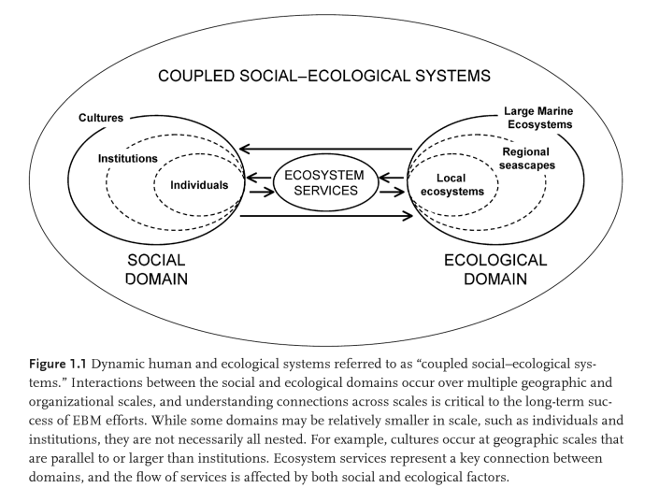
ge

Slide 13
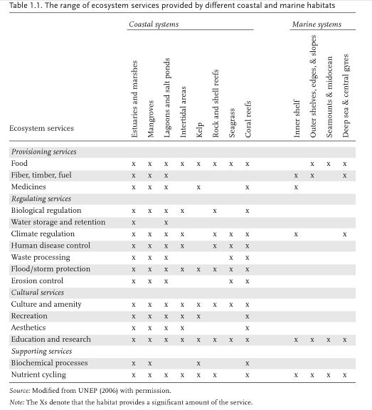
Ecosystem Services
Broader suite than under EBFM.

Slide 14
EBM vs EBFM
EBM is cross-sectoral
Multiple Human Uses
Fisheries Management Plans may still form part of an EBM approach but emphasis is on trying to place fisheries in context of all uses of ecosystem, and all services from ecosystem.
Tools may include those for EBFM
Risk Assessment
Modeling (System models, MSE)
Tradeoff Analysis

Slide 15

Integrated Ecosystem Assessments (IEAs)
What is an IEA?
‘a synthesis and integration of information on relevant physical, chemical, ecological, and human processes in relation to specified management objectives’
(Levin et al., 2008, 2009)
A framework for the process of doing Ecosystem Based Management
e.g. http://www.noaa.gov/iea/

Slide 16
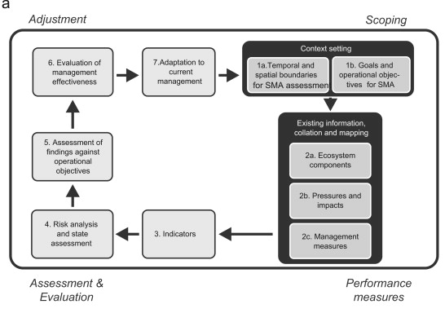
More emphasis on Scoping, articulation of goals, and evaluation for both EBM and spatial plans.
Stelzenmuller et al. (2013) Marine Policy

Slide 17
Governance
Higher level than fisheries management plan process.

Slide 18
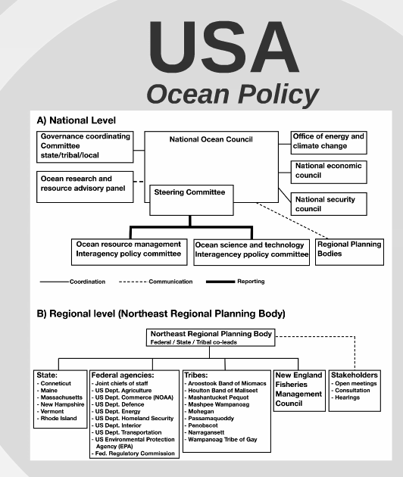

Slide 19
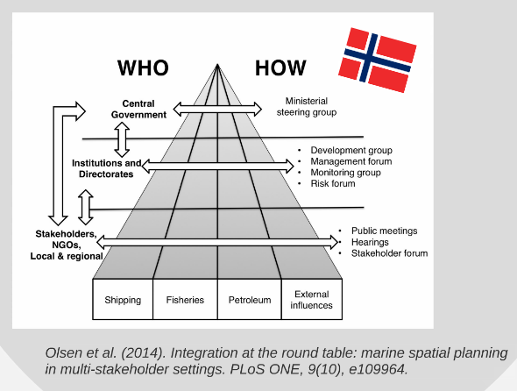
h

Slide 20
Spatial scales and Governance issues
EBM policy at national and multinational scales worldwide.

Slide 21
“ Ecosystems are nested like matryoshka dolls, on scales from the globe as a whole and ocean basins through regional seas, gulfs, and bays down to individual reefs, seagrass beds, and even the mounds made by individual polychaetes.
Jurisdictional lines drawn by governments almost never reflect meaningful biophysical or human-use phenomena—rather, they transect ecosystem boundaries.”
Norse (2010) Bull. Mar. Sci.

Slide 22
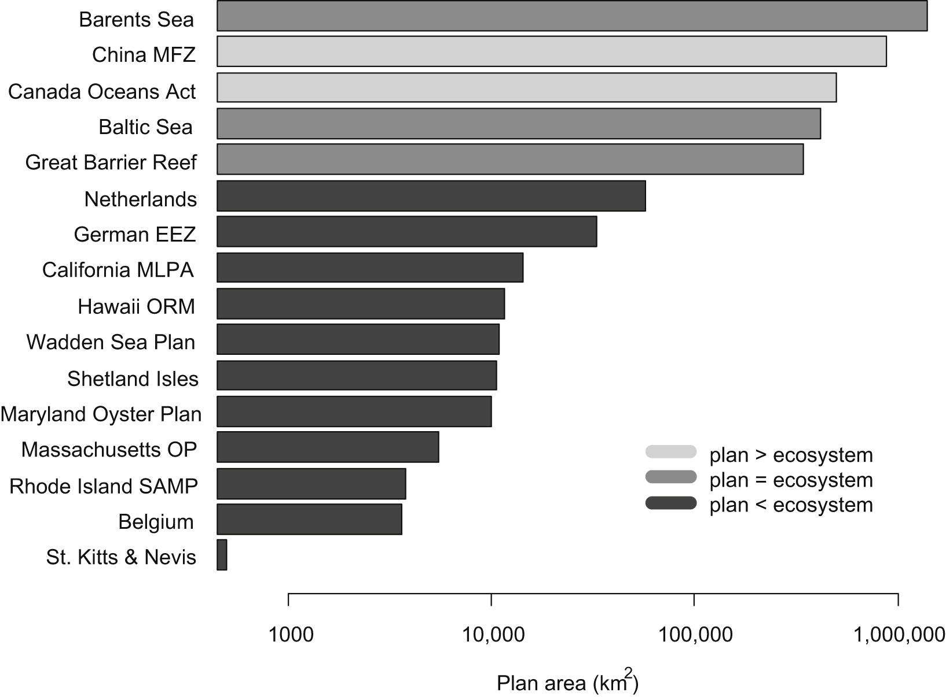
Marine spatial plans span multiple scales
Spatial scale of marine spatial plans. Shading indicates the area of the plan relative to the marine ecosystem: Light gray >, medium gray = , dark gray <.
(Collie et al. 2013)

Slide 23
Spatial scales and Governance issues
EBM policy at national and multinational scales worldwide.
Challenges include fragmented institutional arrangements, entrenched interests, and unresolved jurisdictional complexity.
Requires clear goals, and also coordinating actions of regulatory agencies.
Embrace multitude of scales.
Large scales, overarching policy directives for EBM aim to ensure consistent decision-making.
Local and regional scale planning and implementation also critical.
e.g.
Canada’s Oceans Act – regional planning areas
Australia, marine bioregional planning established as key tool to achieve EBM.
EU Marine Strategy – implementation by member States.
In absence of overarching mandate, large scale change difficult.
Gulf of California – many groups outline need to do EBM at scale of large marine ecosystem, but few changes on the ground.

Slide 24
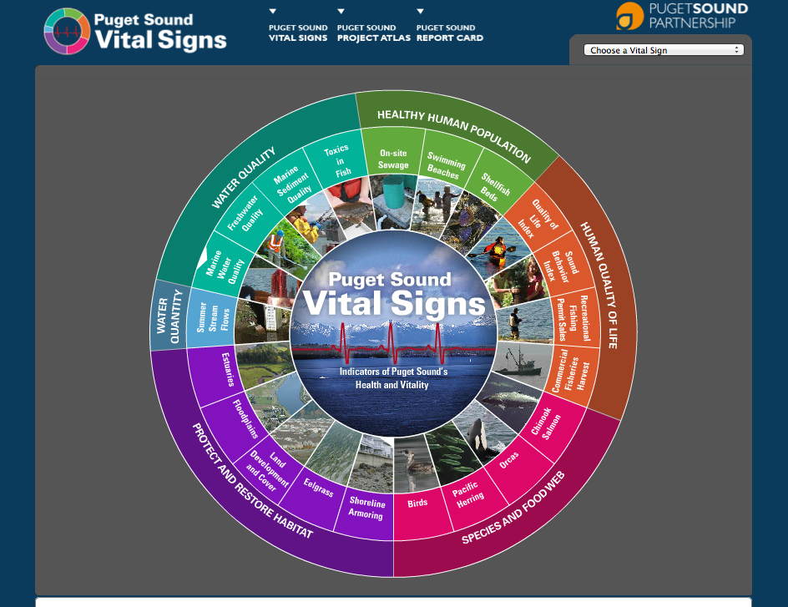
Broadening Constituencies involved in EBM
Emphasize need for engaging stakeholders with diverse interests.
How to do this in meaningful fashion?
How different sub-goals, how do we weight one aim, need, value against another?
Make tradeoffs transparent.
Analytical tools: Multi-criteria Decision Analysis, Delphi method, etc.
Canada, overarching mandate to develop hierarchy of goals and objectives through stakeholder process.
Puget Sound, state appointed Puget Sound Partnership worked with diverse members, scientific working group, and general public to articulate a set of ecosystem goals and initial actions.
Where no mandate exists, process has been through coalitions or civic groups.
San Louis Obispo Science and Ecosystem Alliance (Morro Bay, CA)
PANGAS in Gulf of California.
http://www.psp.wa.gov/vitalsigns/index.php

Slide 25
Hot topics/trends in (marine) EBM
Valuation of Ecosystem Services
Marine Spatial Planning
Multiple Use Management

Slide 26
EBM and spatial management
Much of the work on marine EBM has taken the form of regional spatial planning.
Marine Spatial Planning and Ecosystem Service Valuation often involve creating maps.
GIS software often at the core of these exercises.

Slide 27
Evaluating cumulative impacts Spatial mapping, then weighting of ‘footprint’
Halpern et al. (2009) Cons. Lett.

Slide 28
Marine Spatial Planning

Slide 29
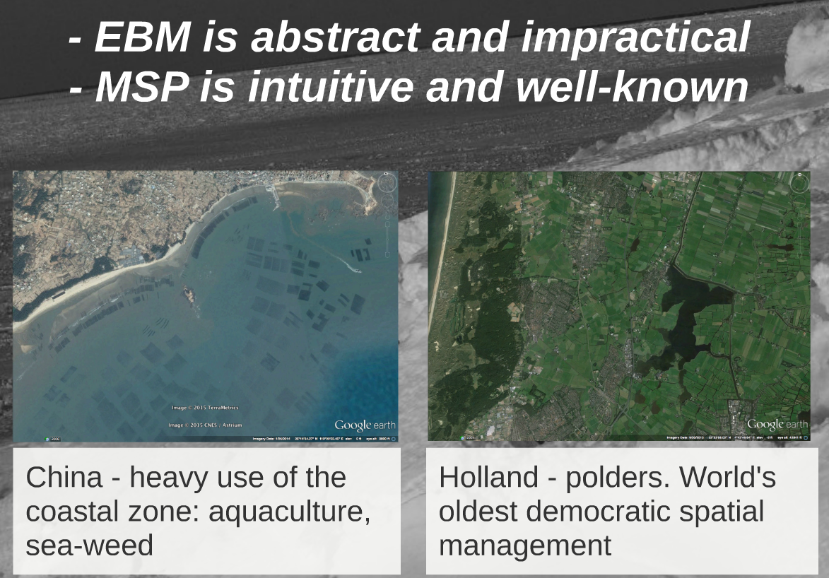
l

Slide 30
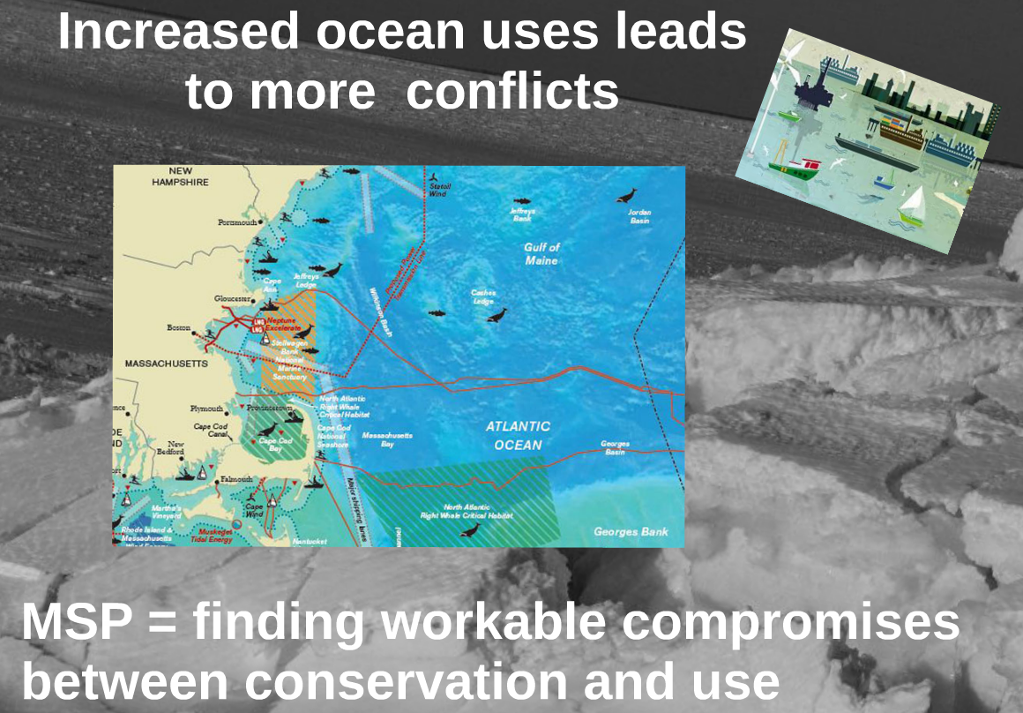
n

Slide 31
Fishing vs energy vs tourism (White et al. 2012)

Slide 32
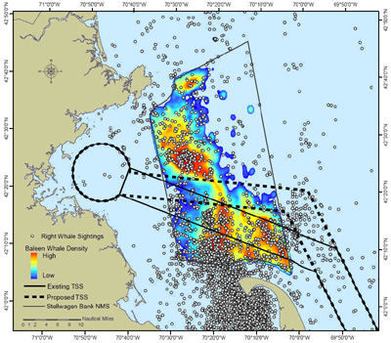
Right whales in Massachusetts, shipping lanes
Risk analysis of ship-strike to whales using maps of whale sightings, habitats, human uses and information on whale feeding ecology.
Shifted shipping lane to reduce ship-strikes.
(NOAA Office of Protected Resources)

Slide 33
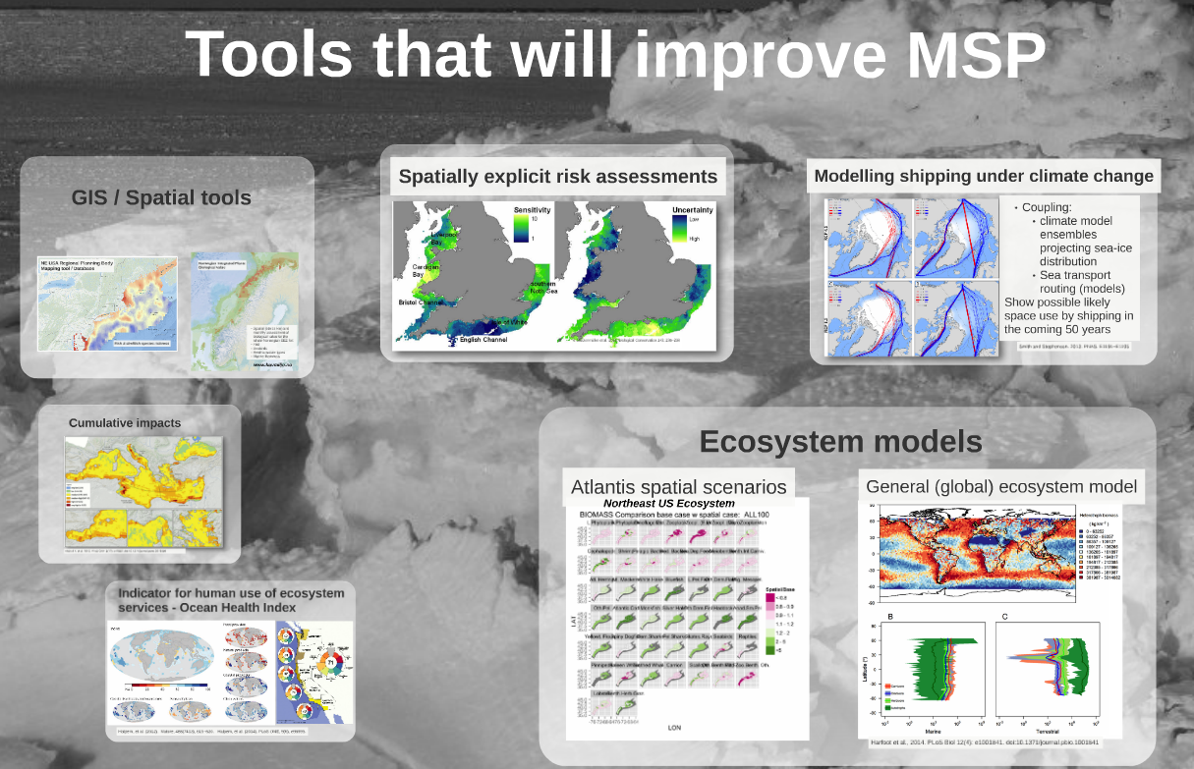
hr

Slide 34
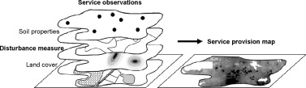
Mapping for valuation of ecosystem services
Mapping of service provision using empirically derived relations between service observations and landscape properties.
(de Groot et al. 2010)

Slide 35
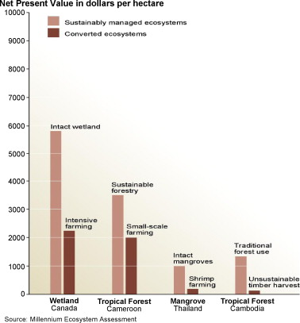
Valuation of ecosystem services
Results often show that when all factors are taken into account properly, multi-functional sustainable use cab be economically more beneficial than conversion into singe-function use
(Balmford et al., 2002)
(de Groot et al. 2010)

Slide 36
Integrated Valuation of Ecosystem Services and Tradeoffs (InVEST)
Suite of models used to map and value goods and services.
Designed to answer questions like:
How will a new coastal management plan impact seafood harvest, renewable energy production, and protection from storms?
Where would reforestation or protection achieve the greatest downstream water quality benefits?
Which parts of a watershed provide the greatest carbon sequestration, biodiversity, and tourism values?
(Natural Capital Project)

Slide 37
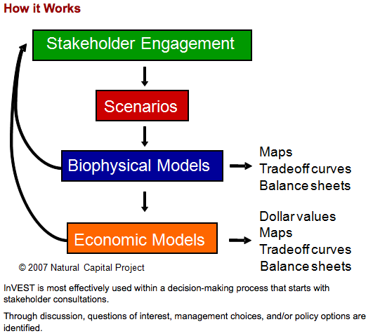
InVEST

Slide 38
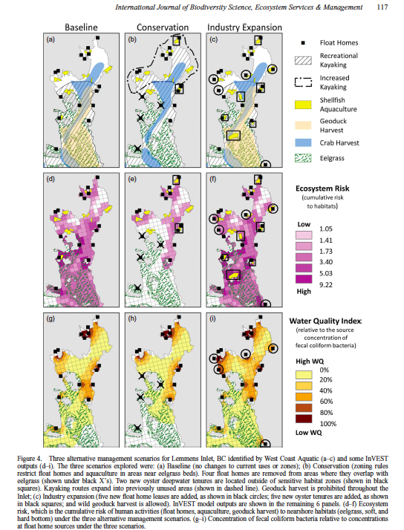
InVEST output
Guerry et al. 2012
Spatial evaluation of management scenarios.
Place-based emphasis.
Combining datasets
Generally static tool

Slide 39
Outstanding research questions for marine EBM
What can we learn from how humans have interacted with coastal and marine environments in the past?
How do we translate knowledge developed at the local scale to broader geographic scales?
What are the cumulative impacts of human activities on ecosystem health and human well-being?
How can trade-offs among ecosystem services and sectors be more systematically assessed?
How do we evaluate the success of ecosystem-based management efforts?
(McLeod & Leslie 2009)

Slide 40
EBM must ultimately include:
A means for sectors to work toward a common goal.
A mix of strategies to allow for protection and use.
Long-term monitoring and research.
Adaptive frameworks that
Allow learning from management action
Test alternate approaches
Readjust as either knowledge or systems change.
(McLeod & Leslie 2009)

Slide 41
Doing EBFM
Questions?

Slide 42
What’s Next?
Final Exam: Project Presentations
Conference style
20 minute time slots
15 minutes presentation
5 minutes for questions
Overview of paper
Key Points

